Slide 1

Minesweeper
Present by:
Vũ Nhật Duy -ITITIU17047

Slide 2
Contents of this Projects
Planning,practical implementation of learned lessons
Implementation of the game
Features of the game
Further implementations

Slide 3
Table of Contents
01
02
03
INTRODUCTION
TEST GAME & DETAIL
ENDING

Slide 4
01
Minesweeper?
INTRODUCTION
A single-player puzzle video game. Originate from the 1960s Written for many computing flatforms in use today

Slide 5
01
Game RUle
INTRODUCTION
1)Clear the board | Clear a board full of unopened cells
2)Don’t hit mines | Mines are hidden in the cells. Don’t hit them!
3)Have Fun!!! | Gaming for more than 180 minutes is bad for your health

Slide 6
02
How to play
GAME MECHANICS
1) Left click | Left click unopened cell to open
2) Right click | Right click the cell to flag
3) The number | The number of mines in the cells neighboring that cell

Slide 7
02
Features
GAME MECHANICS
1) Clear unecessary cells | Use recursion to clear unimportant cells
2) Undo | Use Stack to store player’s moves
3) Difficulties | Adjustable difficulties

Slide 8
03
diagram

Slide 9
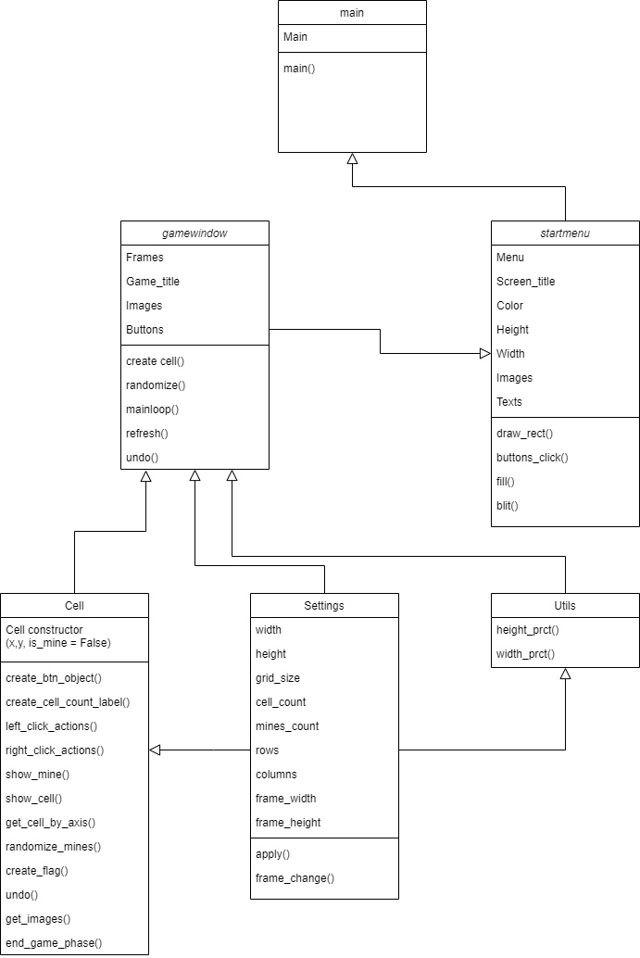
Link: https://app.diagrams.net/#G1jl7mJRS7xQHuWyKMz0ZI9Vb-TQ84ti-T

Slide 10
02
TEST GAME & DETAIL

Slide 11
03
THANK YOU

